Slide 1
What is the Internet doing to me?
(Security and privacy for people in a connected world)
Some legal issues
2 – Privacy, Data Protection, etc
Eoin O’Dell @cearta

Slide 2

Data and Privacy
; image: https://pixabay.com/illustrations/data-binary-one-zero-privacy-2248219/

Slide 3
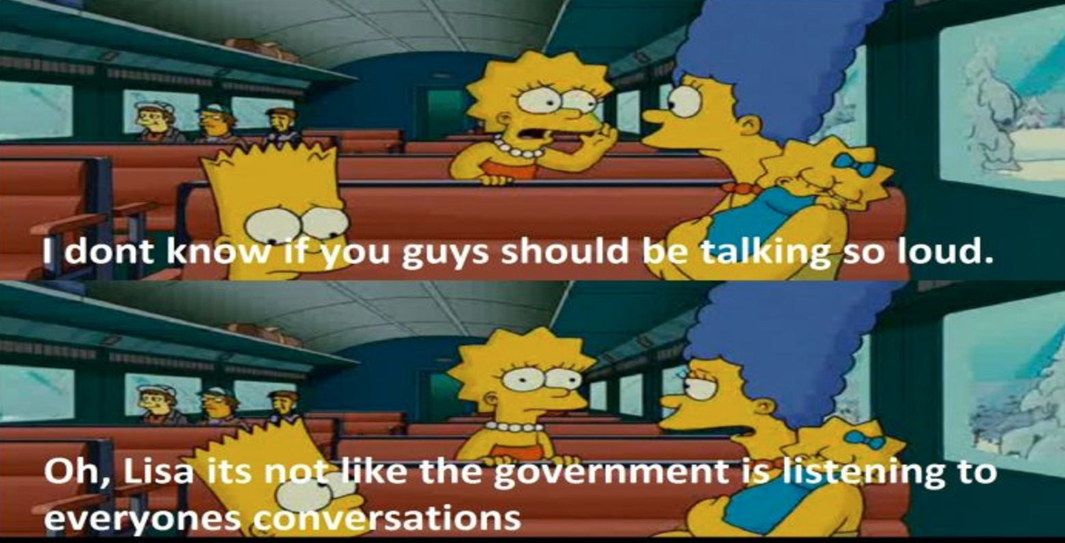
’
; image:
(source link dead); original material: The Simpsons Movie (2007)

Slide 4
Bulk surveillance
’
’
; image:
(source link dead); original material: The Simpsons Movie (2007)

Slide 5
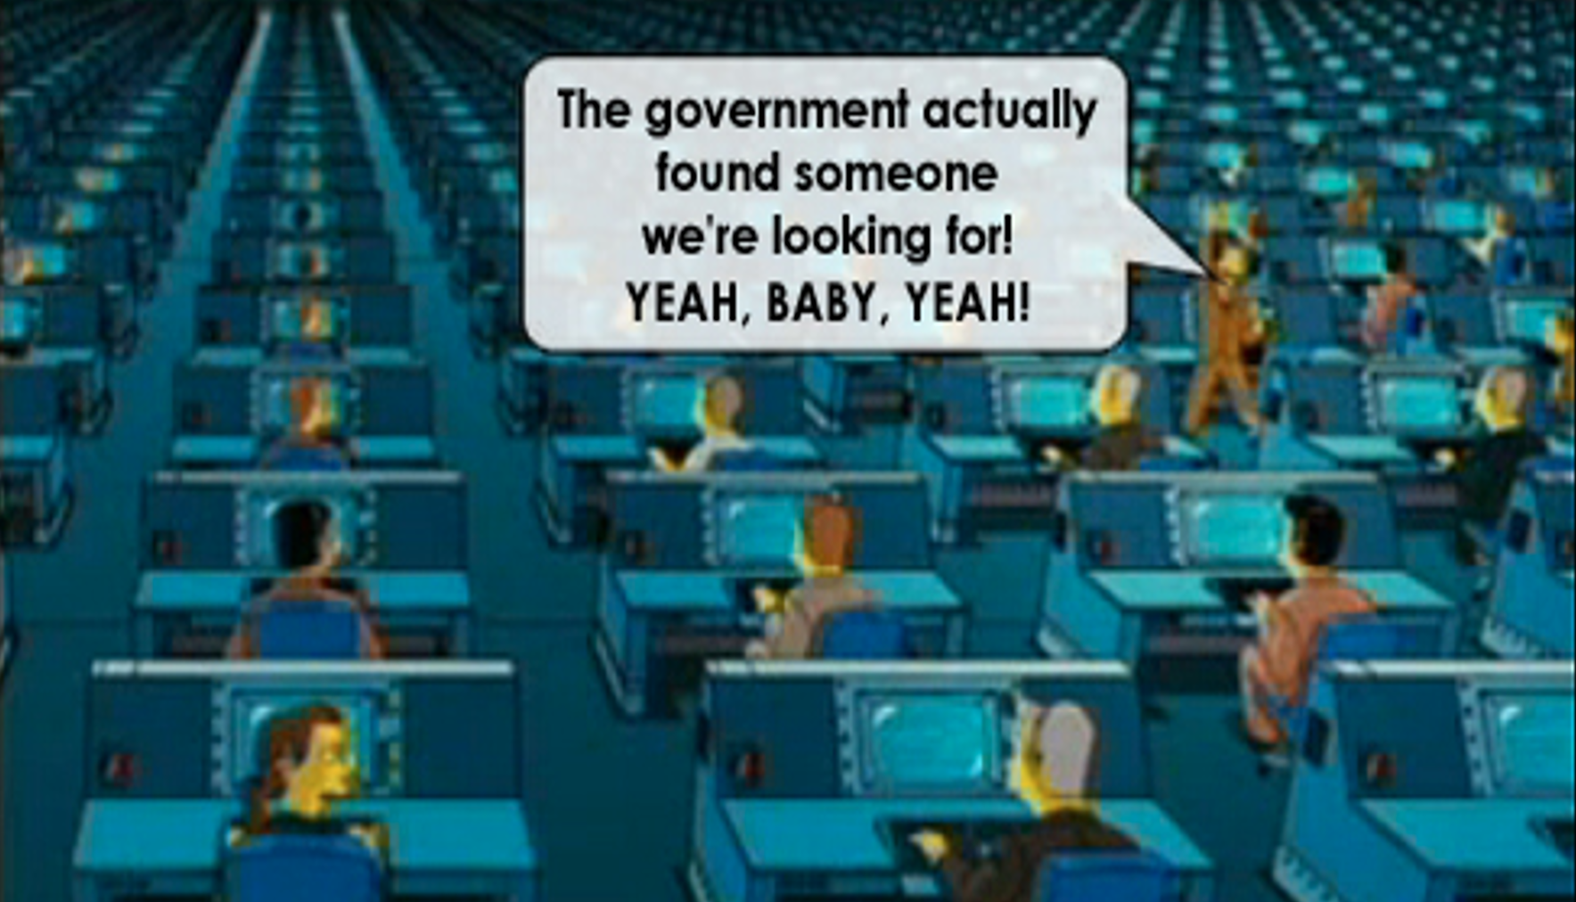
Bulk surveillance
; image:
(source link dead); original material: The Simpsons Movie (2007)

Slide 6


Bulk surveillance
; image:
https://www.flickr.com/photos/jurvetson/51066878912 (element) & http://openclipart.org/people/Last-Dino/prism-logo.svg (2013)

Slide 7
Who is this?
; image:
https://www.flickr.com/photos/jurvetson/51066878912 (element) & http://openclipart.org/people/Last-Dino/prism-logo.svg (2013)

Slide 8
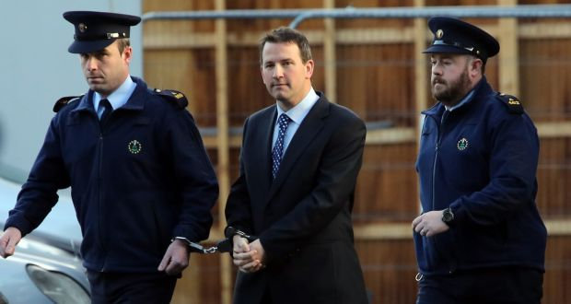

Who is this?
; image:
via https://www.irishtimes.com/news/crime-and-law/graham-dwyer-and-angela-kerins-appeals-among-major-cases-of-2020-1.4119442

Slide 9
Dwyer v Commissioner of An Garda Síochána
[2020] IESC 4 (24 February 2020)
; image:
via https://www.irishtimes.com/news/crime-and-law/graham-dwyer-and-angela-kerins-appeals-among-major-cases-of-2020-1.4119442

Slide 10
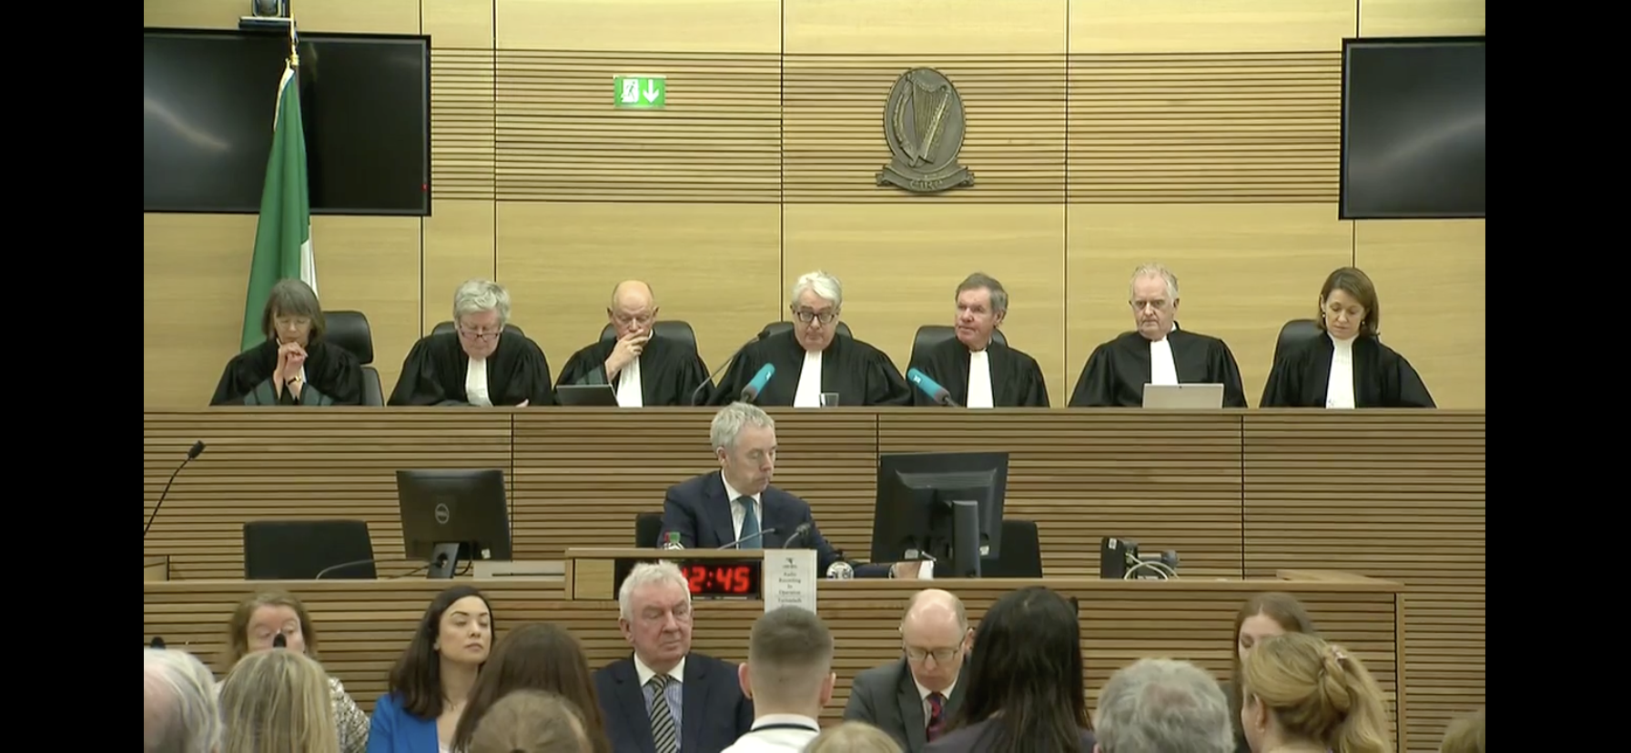
Dwyer v Commissioner of An Garda Síochána
[2020] IESC 4 (24 February 2020)
; image:
Still from live feed via RTE Player

Slide 11
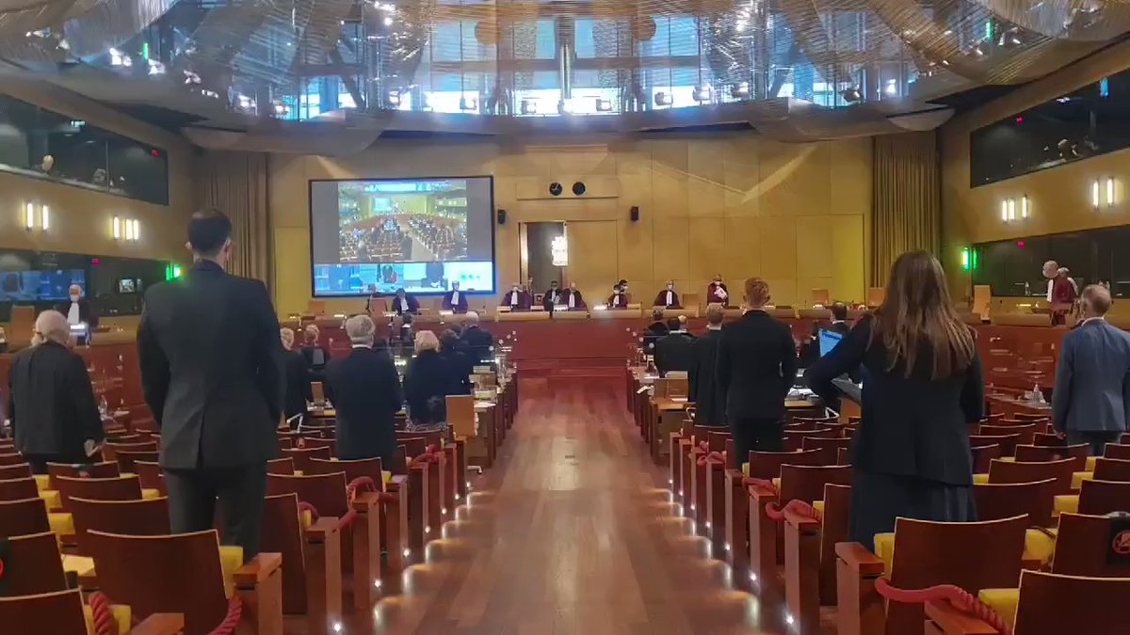
Case C-140/20 GD v Commissioner of the
Garda Síochána (Grand Chamber, 13 Sept 2021)
; image:
https://twitter.com/NaomiOhReally/status/1437319822220595201

Slide 12

; image:
https://www.flickr.com/photos/111692634@N04/18688108466

Slide 13

General Data Protection Regulation
(Regulation (EU) 2016/679) (GDPR)
99 Articles
173 Recitals
21 footnotes
88 pages
; image:
https://pixabay.com/en/gdpr-regulation-protection-data-3438443/

Slide 14

Data Protection Act 2018
; image:
http://www.irishstatutebook.ie/static/images/homepage/2.png

Slide 15

Personal data
; image:
https://pixabay.com/en/business-internet-web-technology-1012761/

Slide 16
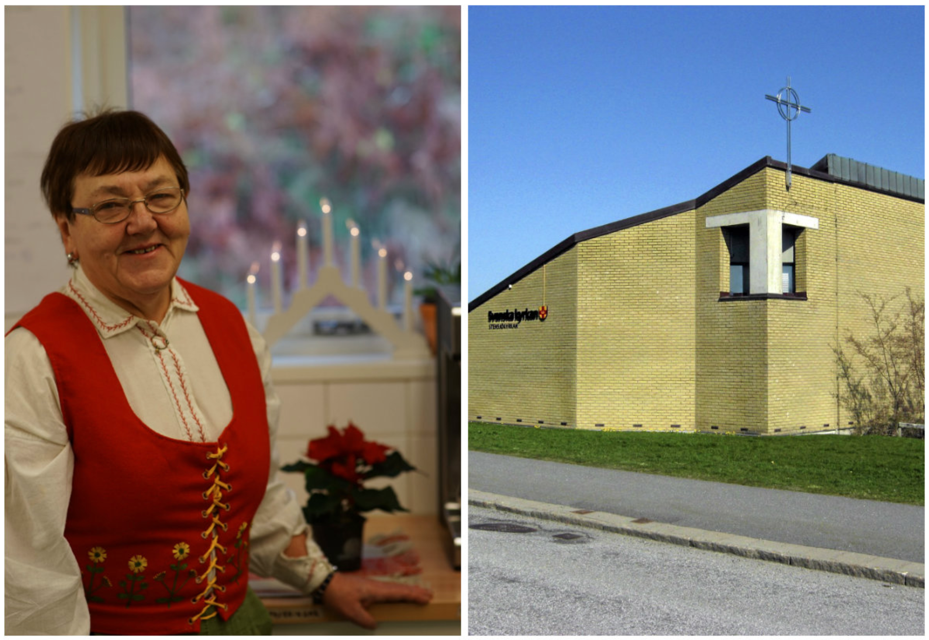
Case C-101/01 Lindqvist
; image:
https://old.molndalsposten.se/nyheter/idag-oppnar-stensjokyrkan-dorrarna/

Slide 17
Case C‑582/14 Breyer
; image:
https://european-pirateparty.eu/terrorist-content-online-regulation-a-boost-to-safety-or-a-threat-to-free-speech-online/

Slide 18
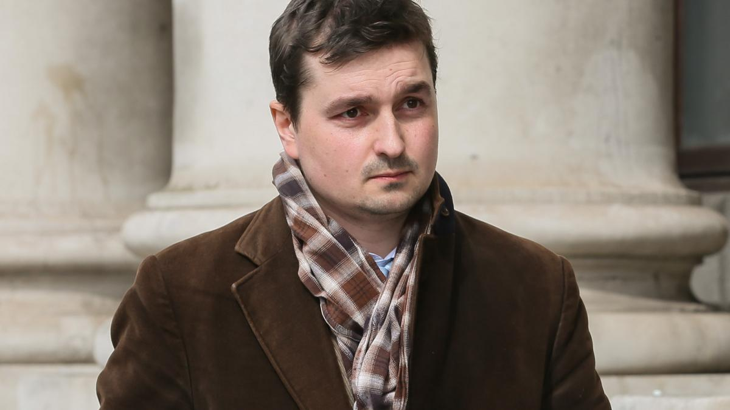
Case C-434/16 Nowak
; image:
https://www.thetimes.co.uk/article/exam-papers-are-personal-data-european-court-rules-mqwblm83v

Slide 19
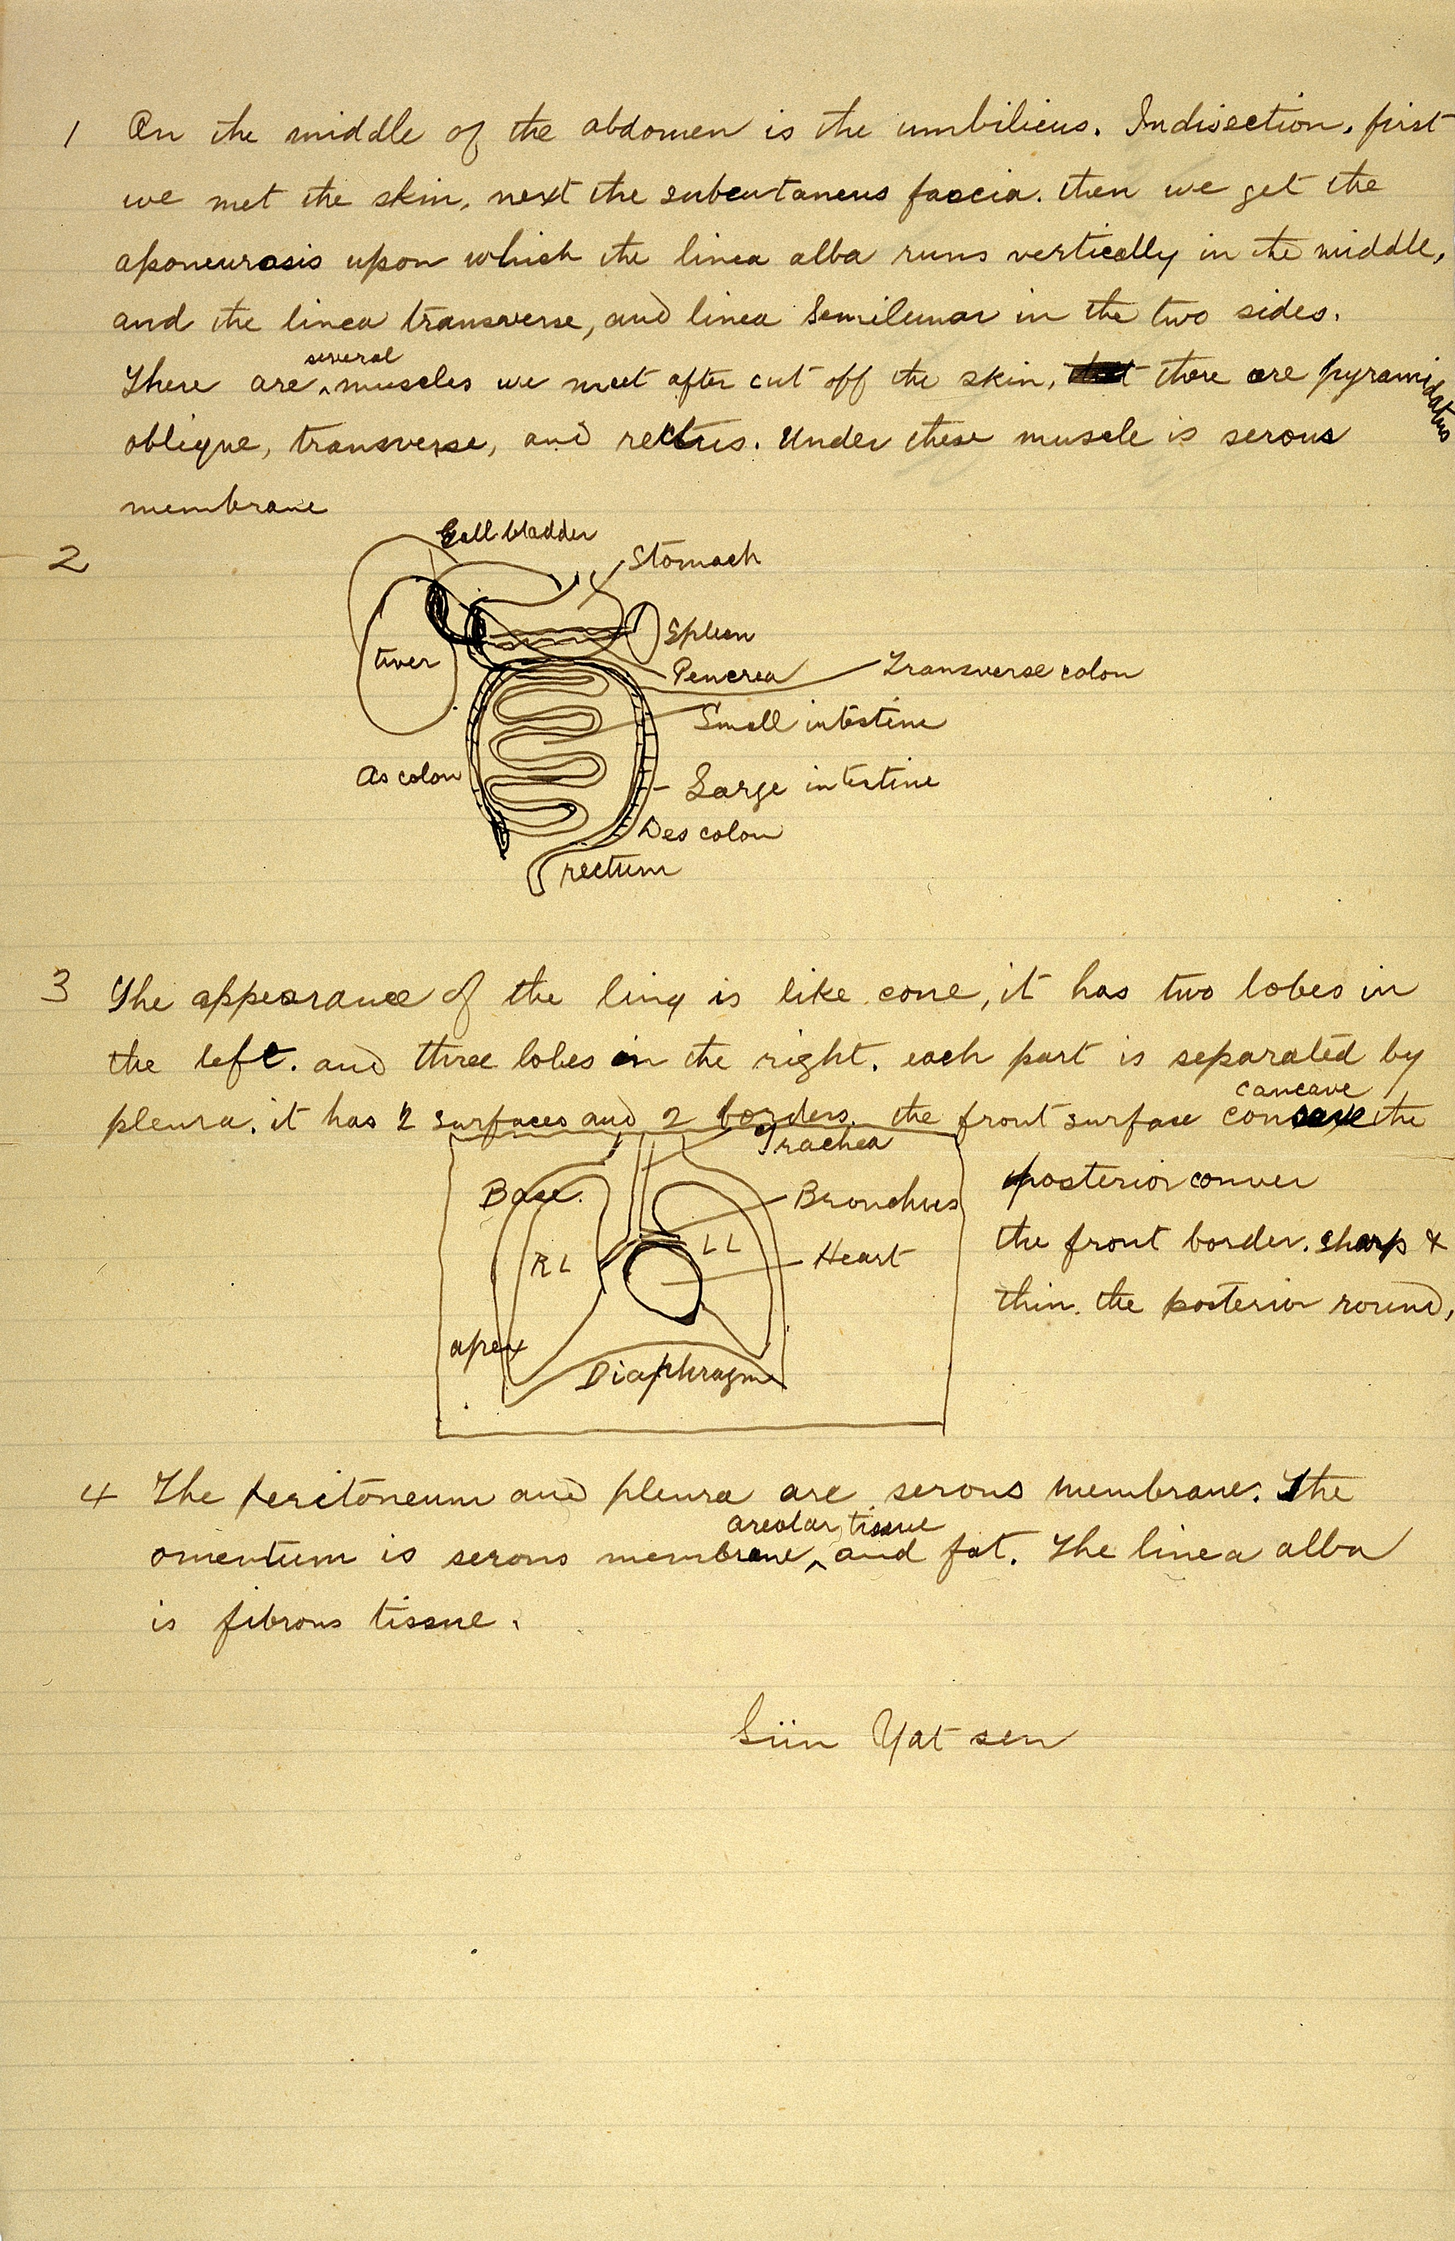
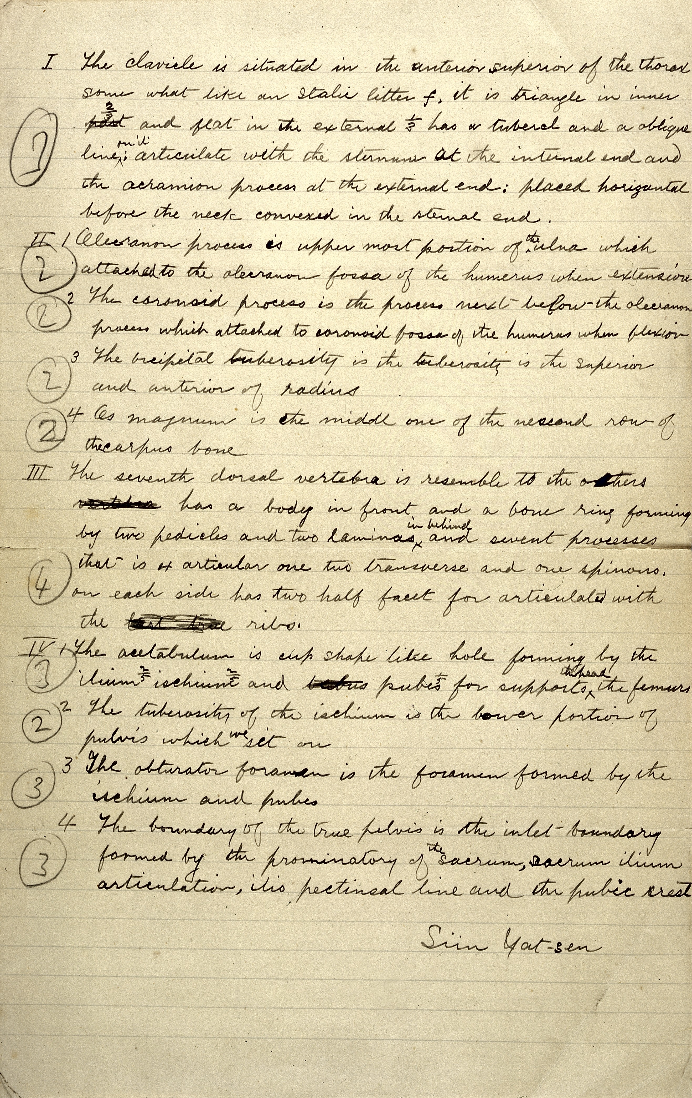
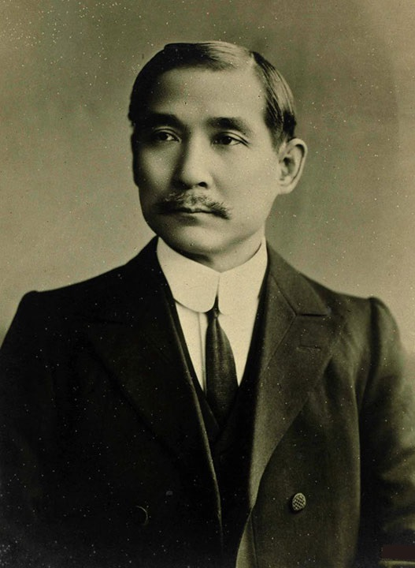
孫逸仙 Sun Yat Sen
; image:
https://en.wikipedia.org/wiki/Sun_Yat-sen#/media/File:Sun_Yat_Sen_portrait_2.jpg

Slide 20
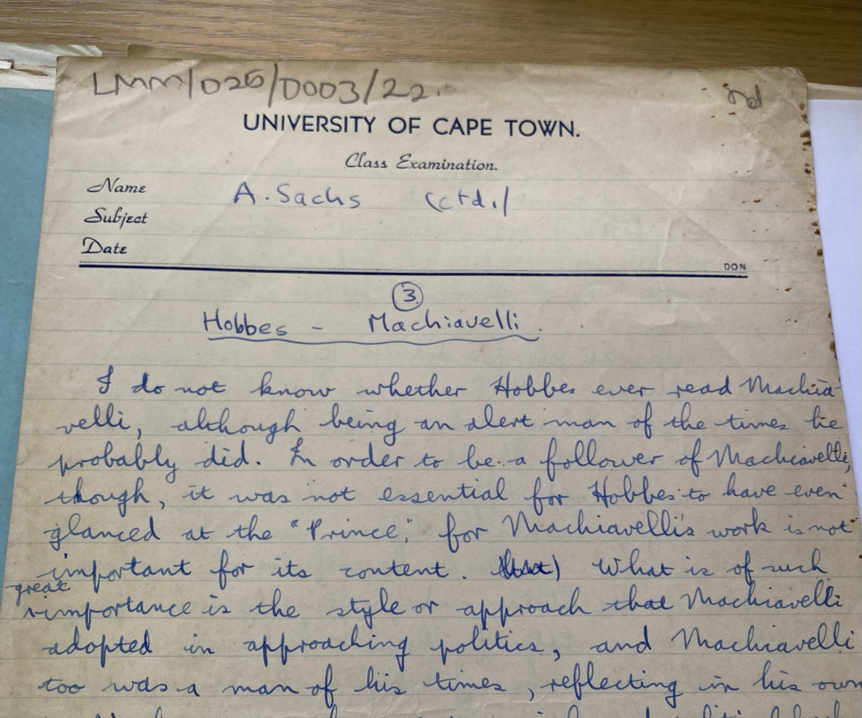

Albie Sachs
; image:
https://www.chr.up.ac.za/world-moot-previous-judges/95-moot-courts/world-moot-court/judges/1646-justice-albie-sachs

Slide 21
Examples of personal data
; image:

Slide 22
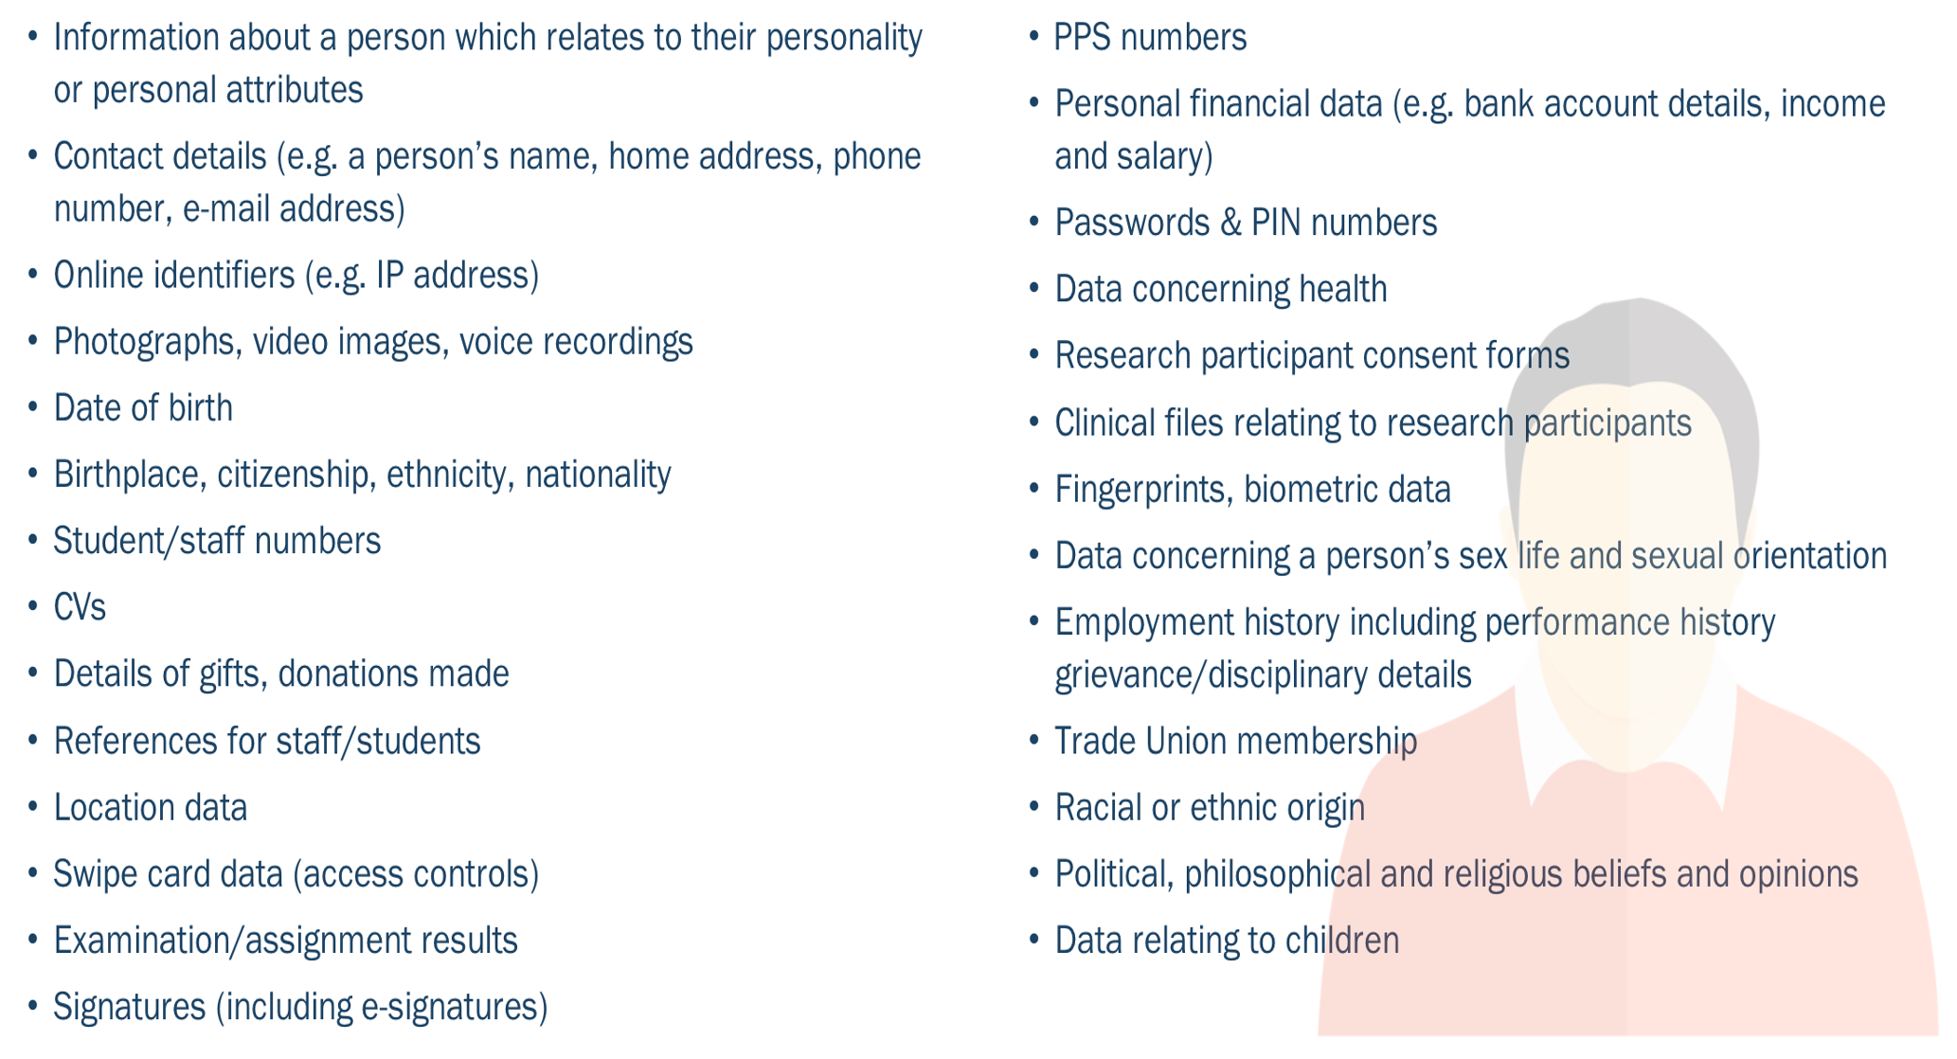
Examples of personal data
Lindqvist
Breyer
Nowak
; image:
via TCD DPO

Slide 23
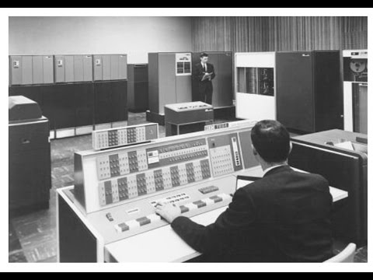
Controllers and Processors
; image:
https://www.youtube.com/watch?v=wIjgZhAjQS4 (element; still 20:36)

Slide 24
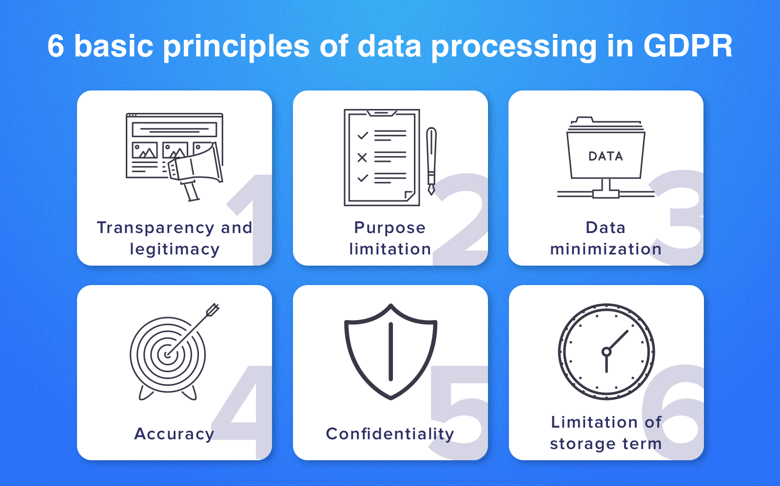
Art 5(1) GDPR - Principles
; image:
https://www.cleveroad.com/images/article-previews/basic-principles-1.png
https://about.fb.com/news/2019/09/privacy-matters-dating/
https://www.dataprotection.ie/en/news-media/press-releases/dpc-statement-facebook-dating-feature

Slide 25
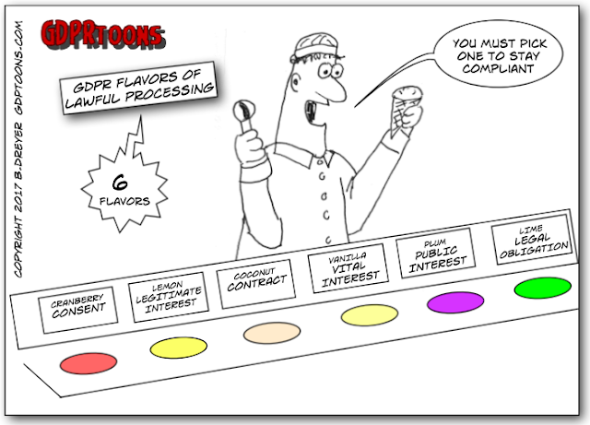

Article 6 GDPR – lawfulness of processing
Cranberry
Consent [of data subject]
freely given, specific, informed & unambiguous
; images:
http://www.gdprtoons.com/2017/08/the-gdpr-provides-six-6-grounds-for_29.html
& https://pixabay.com/en/icecream-cone-scoop-chocolate-ice-32104/

Slide 26
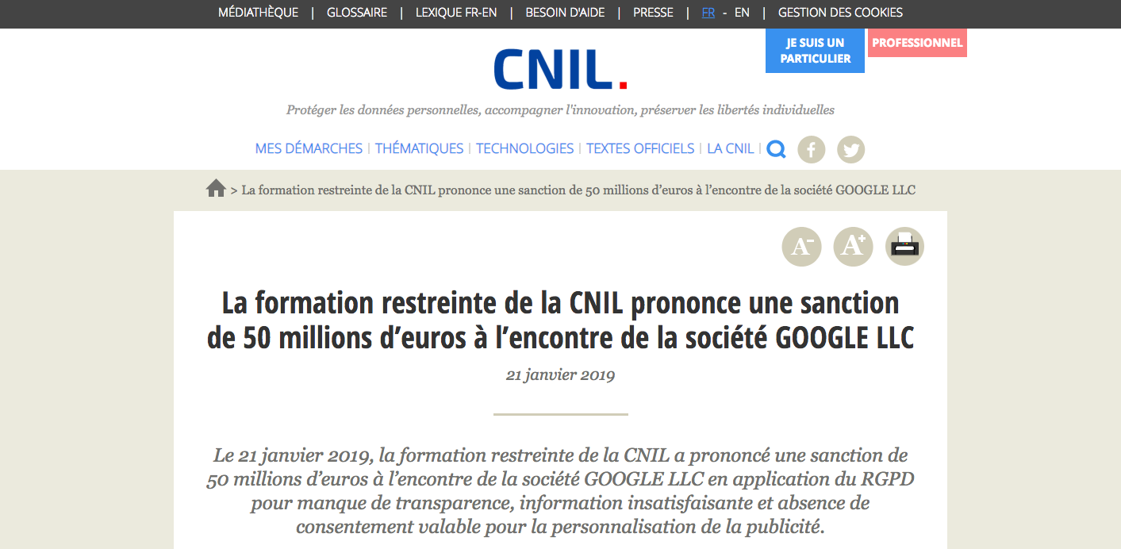
CNIL / Google
; image:
https://www.cnil.fr/fr/la-formation-restreinte-de-la-cnil-prononce-une-sanction-de-50-millions-deuros-lencontre-de-la

Slide 27
Article 6 GDPR – lawfulness of processing
Cranberry
Consent [of data subject]
freely given, specific, informed & unambiguous
; images:
http://www.gdprtoons.com/2017/08/the-gdpr-provides-six-6-grounds-for_29.html
& https://pixabay.com/en/icecream-cone-scoop-chocolate-ice-32104/

Slide 28
Article 6 GDPR – lawfulness of processing
Cranberry
Consent [of data subject]
Lemon
Legitimate
interest [of controller]
Coconut
Contract
; images:
http://www.gdprtoons.com/2017/08/the-gdpr-provides-six-6-grounds-for_29.html
& https://pixabay.com/en/icecream-cone-scoop-chocolate-ice-32104/

Slide 29
Article 6 GDPR – lawfulness of processing
Vanilla
Vital
interest [of data subject]
Plum
Public interest
Lime
Legal obligation [on controller]
; images:
http://www.gdprtoons.com/2017/08/the-gdpr-provides-six-6-grounds-for_29.html
& https://pixabay.com/en/icecream-cone-scoop-chocolate-ice-32104/

Slide 30

Art 9 GDPR – special categories
; image:
https://pixabay.com/en/special-word-letters-books-school-1959563/

Slide 31

Art 9(1) GDPR – prohibitions
The processing of personal data revealing
racial or ethnic origin,
political opinions,
religious or philosophical beliefs, or
trade-union membership, …
shall be prohibited.
; image:
https://pixabay.com/en/special-word-letters-books-school-1959563/

Slide 32
Art 9(1) GDPR – prohibitions
The processing of
genetic data,
biometric data for the purpose of uniquely identifying a natural person,
data concerning health, or
data concerning a natural
person’s sex life or sexual
orientation,
shall be prohibited.
; image:
https://pixabay.com/en/special-word-letters-books-school-1959563/

Slide 33
Art 9(2) GDPR – up to 10 exceptions
Paragraph 1 shall not apply if one of the following applies:
(a) data subject has given explicit consent, ...
(c) necessary to protect vital interests, ...
(g) necessary for substantial public interest,
(h) necessary for preventative
medicine, or health or
social care,
; image:
https://pixabay.com/en/special-word-letters-books-school-1959563/
& https://pixabay.com/en/icecream-cone-scoop-chocolate-ice-32104/

Slide 34
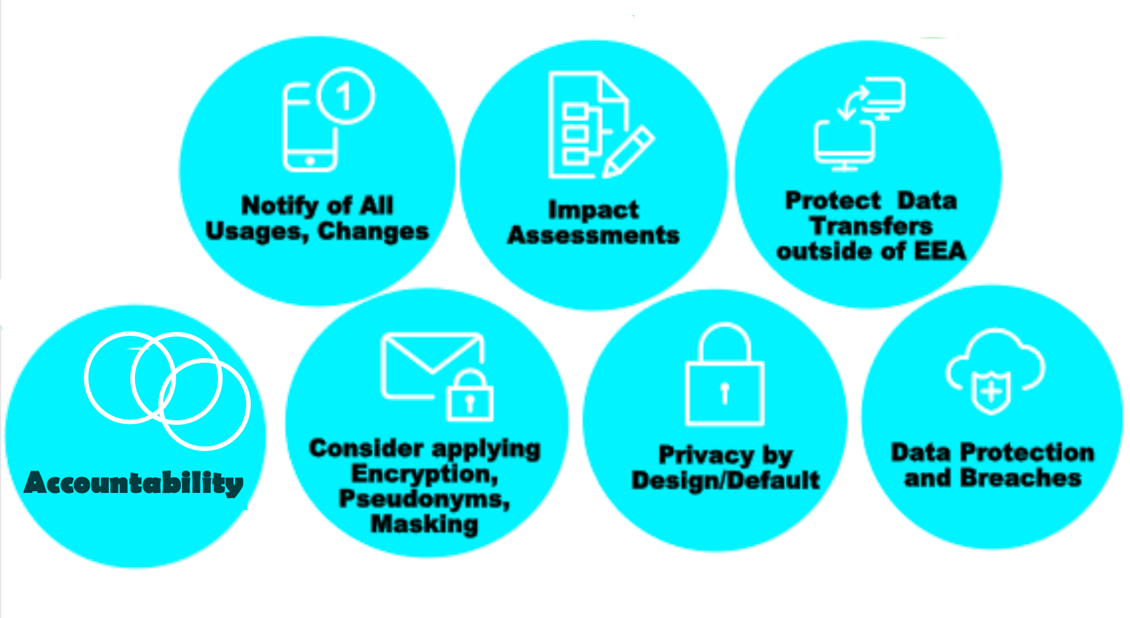


Obligations of Controllers
; image:
https://financialservicesblog.accenture.com/six-practical-steps-for-hr-managers-to-become-gdpr-ready (element) (modified)

Slide 35

Obligations of Controllers
; image:
https://en.wikipedia.org/wiki/WhatsApp

Slide 36

Obligations of Controllers
a fine of €225 million
; image:
https://www.dataprotection.ie/en/news-media/press-releases/data-protection-commission-announces-decision-whatsapp-inquiry

Slide 37
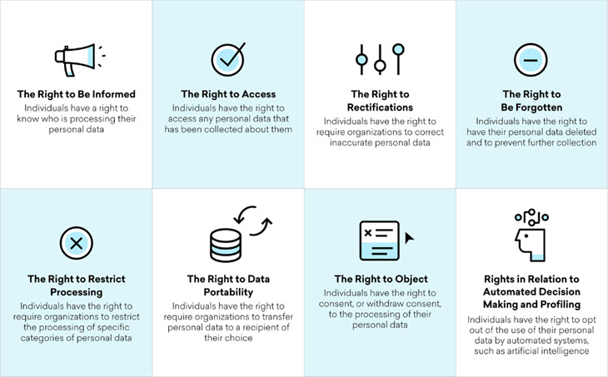
GDPR Data Subject Rights
passim Art 15 (&19) Art 16 (&19) Art 17 (&19)
Art 18 Art 20 Art 21 Art 22
; image:
http://www.nuigalway.ie/media/informationsolutionsservices/images/servicesforstaffsection/security/Rights.jpg

Slide 38


GDPR Data Subject Rights
Art 15 (&19) Art 16 (&19) Art 17 (&19)
; image:
http://www.nuigalway.ie/media/informationsolutionsservices/images/servicesforstaffsection/security/Rights.jpg

Slide 39
GDPR Data Subject Rights
Art 15 (&19) Art 16 (&19) Art 17 (&19)
; image:
http://www.nuigalway.ie/media/informationsolutionsservices/images/servicesforstaffsection/security/Rights.jpg

Slide 40


Any Questions?
; image http://maxpixel.freegreatpicture.com/static/photo/640/Empty-Old-Leave-Chalk-Board-School-
Blackboard-73496.png

